Slide 1
Analyzing Content Growth & Engagement of Five Brands on LinkedIn
Presented By
BIBEK LAMSAL

Slide 2
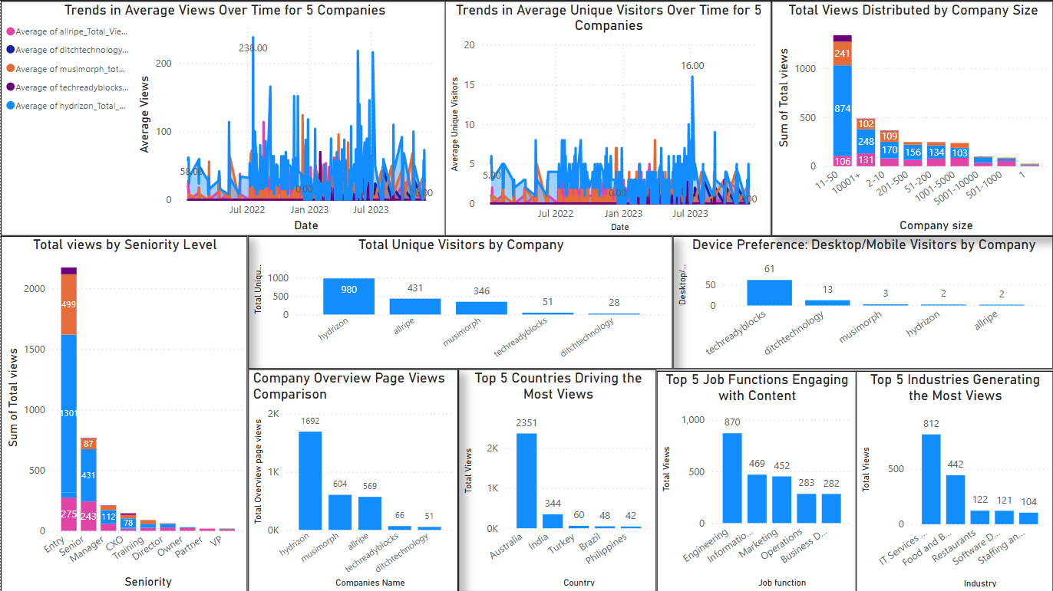
Visualization using dashboard

Slide 3
Insight:
Hydrizon leads in total views and unique visitors: It has the highest number of unique visitors (980) and total page views (1692), making it the most visited company among the five.
Musimorph and Allripe are in second place: Musimorph has 604 total views, and Allripe has 569. However, Allripe has a slightly higher number of unique visitors (431) compared to Musimorph (346).
Small companies dominate the views: The highest number of views comes from companies with 11 to 50 employees, indicating strong engagement from small-level businesses.
Entry-level professionals contribute the most views: Most of the total views come from the entry-level positions, followed by senior managers and CXOs
Australia contributes the most traffic: With 2,351 total views, India leads in engagement, followed by India (344). Other countries such as Turkey, Brazil, and the Philippines have significantly lower engagement
Engineering and IT services dominate job function and industry views: Engineering professionals contributed the highest number of job function-based views (870), while IT services led industry-based views (812).

Slide 4
Recommandation
Target small Businesses: Develop content focused on SMB growth—challenges, success stories, funding tips, and tech adoption.
Boost Engagement in Australia with Localized Content: Create region-specific posts highlighting trends, insights, and success stories. Collaborate with local influencers and optimize LinkedIn Ads for better reach..
Enhance User Acquisition for Techreadyblocks & Ditchtechnology: Experiment with videos, infographics, and carousel posts. Encourage employees to engage with and share content. Leverage LinkedIn SEO trending hashtags, active discussions, and consistent posting to expand reach.

Slide 5
Call Through Action
Let’s set a meeting with the content creation team to strategize collaboration with local influencers and optimize LinkedIn Ads for more reach.

